Slide 1
Logic Gates using Transistors
JAMEEL AHME KUSTAGI

Slide 2
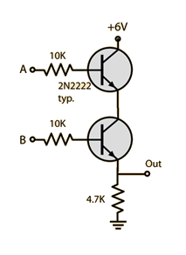
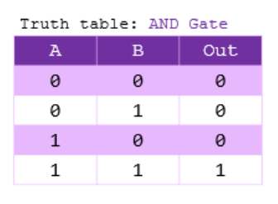
Transistor AND Gate
The AND logic, the transistors are in series and both transistors must be in the conducting state to drive the output high.

Slide 3
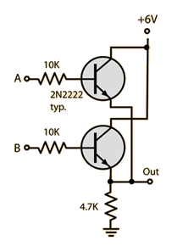
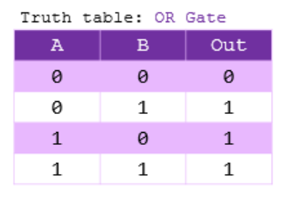
Transistor OR Gate
The OR logic, the transistors are in parallel and the output is driven high if either of the transistors is conducting.

Slide 4
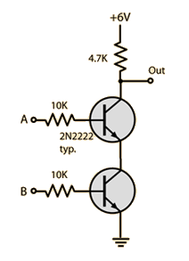
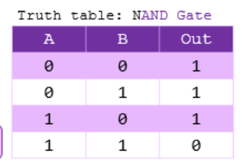
Transistor NAND Gate
the NAND logic, the transistors are in series, but the output is above them. The output is high unless both A and B inputs are high, in which case the output is taken down close to ground potential.

Slide 5
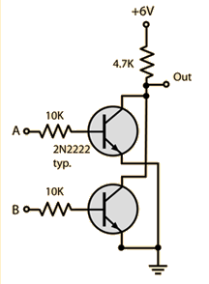
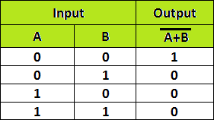
Transistor NOR Gate
The NOR logic, the transistors are in parallel with the output above them so that if either or both of the inputs are high, the output is driven low.

Slide 6
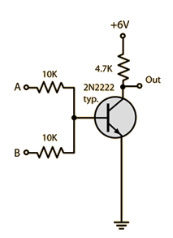
Transistor NOR Gate
NOR logic, only one transistor is used with the two inputs tied to its base through resistors. If either or both of the inputs is high, the output is driven low.

Slide 7
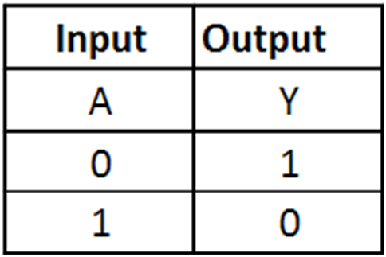
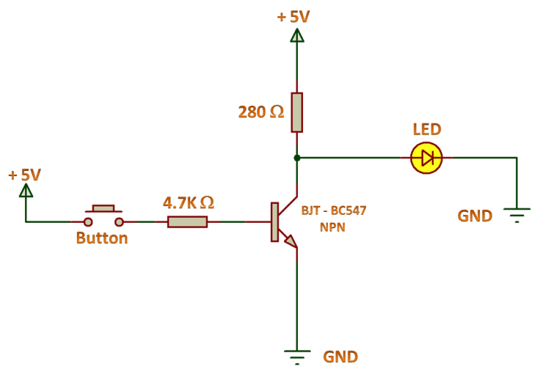
NOT Gate Using NPN Transistor

